Slide 1




A Project Presentation on
AI-Driven Stock Price Prediction and Real-Time News Sentiment Analysis
Under The Guidance of :
Prof. Mangal Wagh
Presented by:
7403 - Simrah Awati
7405 - Aashish Bagmar
7413 - Aarya Jadhav
7431 - Eshwari Bhandkar
B.E Artificial Intelligence and Data Science
.
AI & DS - Department
APCOER, Pune

Slide 2
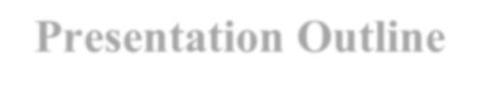

Presentation Outline
Introduction
Problem Statement
Motivation
Research Objectives
Research
Existing Systems
Literature Survey
Proposed System
System Architecture / Modular Diagram
Research Methodology
Algorithm
Mathematical Model
13. UML Diagram
14. Data Flow Diagram
15. Activity Diagram
16. Tools and Technologies
17. Results and Discussion
18. Evaluation metrics
19. Test Cases
20. Conclusion
21. Future Scope
AI&DS-Department​
2
APCOER, Pune

Slide 3

Introduction
The stock market is unpredictable due to constant fluctuations and external influences. Traditional models rely only on historical data and miss real-time insights. This projects uses AI and news sentiment analysis to improve predictions accuracy and help investors make smarter decisions.
APCOER, Pune

Slide 4
Problem Statement
The stock market is highly volatile and influenced by multiple dynamic factors, making accurate prediction difficult. Existing models fail to combine real-time sentiment analysis with quantitative forecasting, creating the need for an AI-based hybrid system that delivers adaptive and interpretable market predictions.
APCOER, Pune

Slide 5
Motivation
The volatility and unpredictability of financial markets demand systems that can adapt and learn dynamically.
Investors often struggle with data saturation, rapid market fluctuations and emotion-driven decision-making.
AI-based forecasting models uncover hidden temporal and non-linear dependencies that traditional methods overlook.
Sentiment analysis introduces a behavioral perspective, capturing
the psychological drivers of market movement such as optimism and fear.
Combining predictive analytics with sentiment intelligence forms
a comprehensive decision-support framework, enhancing accuracy, confidence
and risk assessment
APCOER, Pune

Slide 6

Research Objectives
Collect and preprocess stock and news data from APIs.
Build an LSTM model for time-series stock prediction.
Use FinBERT for sentiment classification of financial news.
Integrate both modules in a streamlit web platform with live visualization.
Evaluate accuracy using MSE, RMSE and correlation metrics.
Provide a decision-support tool for investors and analysts.
APCOER, Pune

Slide 7
Research Objectives achieved in Sem-I
Studied existing stock price prediction methods and performed literature review.
Collected historical stock market data using financial APIs (like Yahoo Finance).
Performed data preprocessing and exploratory data analysis on stock datasets.
Selected suitable machine learning algorithms for stock trend prediction.
Designed the system architecture for prediction and sentiment analysis modules.
APCOER, Pune

Slide 8
Research Objectives achieved in Sem-II
Developed the stock price prediction model using Machine Learning.
Implemented sentiment analysis for financial news classification.
Classified news into Positive, Negative and Neutral categories.
Integrated prediction and sentiment modules into a Streamlit.
Performed system testing and accuracy evaluation. Completed model integration and deployment.
APCOER, Pune

Slide 9

Existing Systems
Most existing approaches:
Use only historical stock price data for prediction.
Rely on models like Linear Regression and basic Machine Learning.
Do not consider real-time news or market sentiment.
Cannot predict sudden changes caused by news, political events or global crises.
Mostly provide static dashboards instead of live analysis.
As a result, their prediction accuracy is limited.
APCOER, Pune

Slide 10

Literature Survey
Author(s) & Year | Method / Model Used | Key Findings | Research Gap
Liu et al. (2020) | FinBERT (Transformer-based NLP Model) | Improves financial sentiment classification accuracy | Not combined with real-time prediction framework
Bollen et al. (2021) | Sentiment Analysis using Twitter Data | Public sentiment strongly affects stock trends | Uses only historical / social data
Patel et al. (2022) | SVM, Random Forest, ANN (Hybrid ML Models) | Improves prediction accuracy using ML models | No sentiment integration
Kumar & Roy (2023) | NLP-based Sentiment-aware Model | Shows sentiment impacts short-term market movements | Limited integration with prediction systems
Zhang et al. (2023) | LSTM (Long Short-Term Memory) | Captures time-series dependencies effectively | Sentiment not integrated with ML prediction
APCOER, Pune

Slide 11
Proposed System
The system combines historical stock data with real-time news sentiment analysis
Uses two main modules:
Stock Prediction Module (predicts price trend using ML models like LSTM / Random Forest).
Sentiment Analysis Module (analyzes financial news using NLP models like BERT / FinBERT).
Collects data from financial APIs and news sources.
Processes numerical data and classifies sentiment as positive, negative or neutral.
Integrates both prediction results to improve overall accuracy.
Developed as a web-based application using Python and Streamlit.
Displays outputs through interactive dashboards and visualizations.
Helps investors make better and faster investment decisions.
Result: More accurate, intelligent, and real-time stock market prediction system.
APCOER, Pune

Slide 12
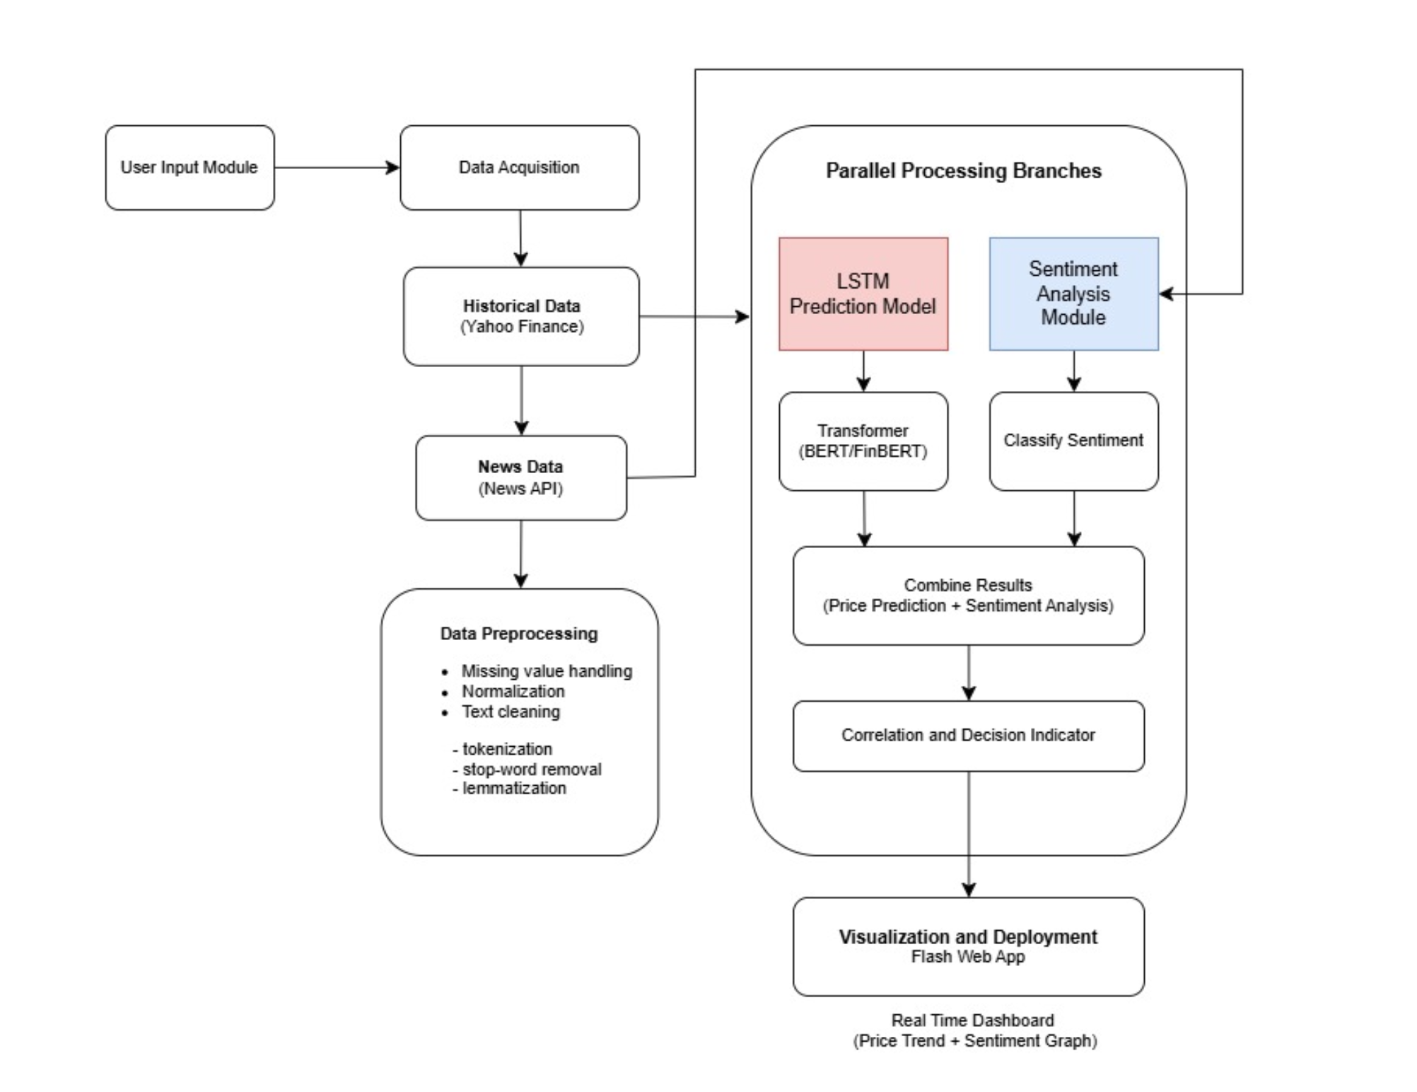
System Architecture
APCOER, Pune

Slide 13
Methodology
To develop an AI-based model for predicting stock price trends using historical market data.
To perform real-time sentiment analysis of financial news using Natural Language Processing (NLP).
To integrate numerical stock data with news sentiment for improved prediction accuracy.
To design an interactive web-based system for visualization of stock trends and sentiment results.
To provide a decision-support tool that helps investors understand market behavior more effectively.
APCOER, Pune

Slide 14
Algorithm
Model | Strength | Limitation | Purpose (Why Used)
Linear Regression | Simple, fast, easy to interpret | Cannot handle complex patterns | Used as baseline model for basic trend analysis
Random Forest | Handles non-linear data, reduces overfitting | Less interpretable, more computation | Used for improving accuracy on complex datasets
LSTM | Captures time-series patterns, remembers past data | High complexity, needs more data | Used for stock prediction (sequential/time-based data)
APCOER, Pune

Slide 15
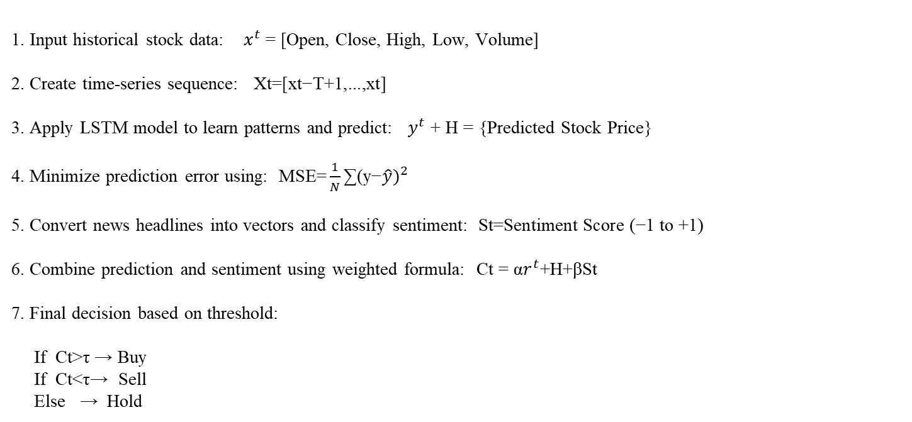
Mathematical Model
1. Input historical stock data: $x^{t}$ = [Open, Close, High, Low, Volume]
2. Create time-series sequence: $\text{Xt}\text{​=[}\text{xt}\text{−}\text{T}\text{+1​,...,}\text{xt}\text{​]}$
3. Apply LSTM model to learn patterns and predict: $y^{t}$+ H​ = {Predicted Stock Price}
4. Minimize prediction error using: $\text{MSE}\text{=}\frac{1}{N}\text{​∑}{\text{(}\text{y}\text{−}\hat{y}\text{​})}^{2}$
5. Convert news headlines into vectors and classify sentiment: $\text{St}\text{​=}\text{Sentiment} \text{Score} \text{(−1 }\text{to}\text{ +1)}$
6. Combine prediction and sentiment using weighted formula: $\text{Ct}\text{​ = }\text{α}r^{t}\text{+}\text{H}\text{​+}\text{β}\text{St}\text{​}$
7. Final decision based on threshold:
If $\text{Ct}\text{​>}\text{τ}$ → Buy
If Ct​<τ→ Sell
Else → Hold
APCOER, Pune

Slide 16
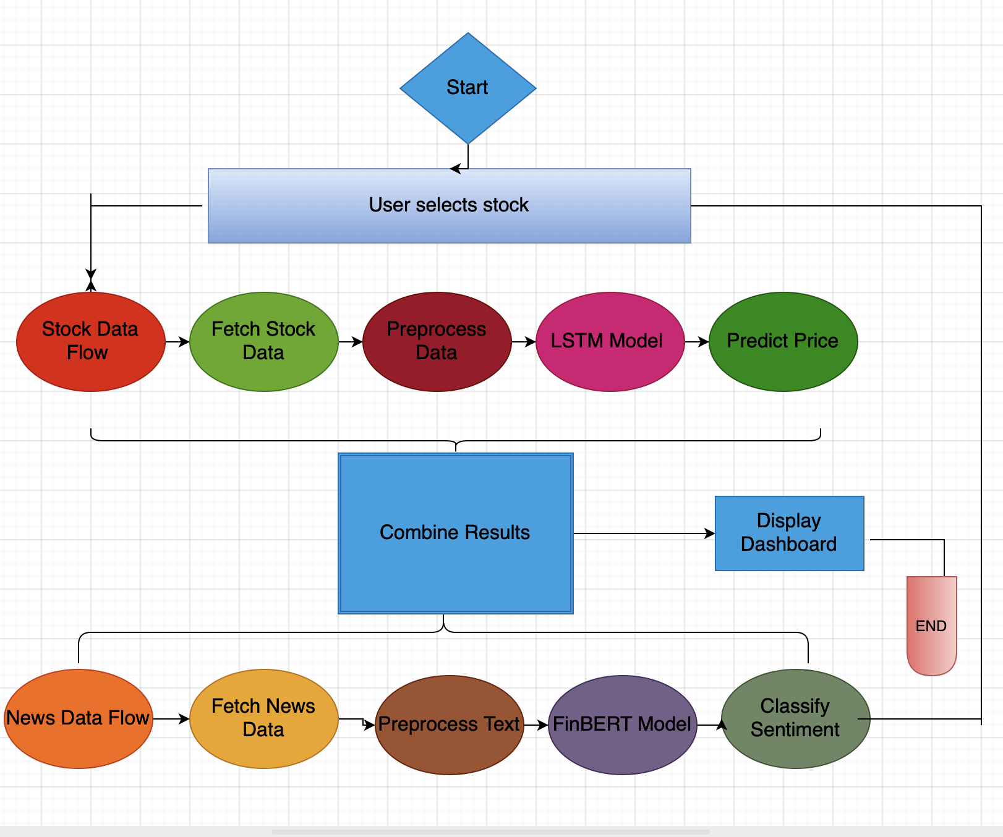
UML Diagram
APCOER, Pune

Slide 17

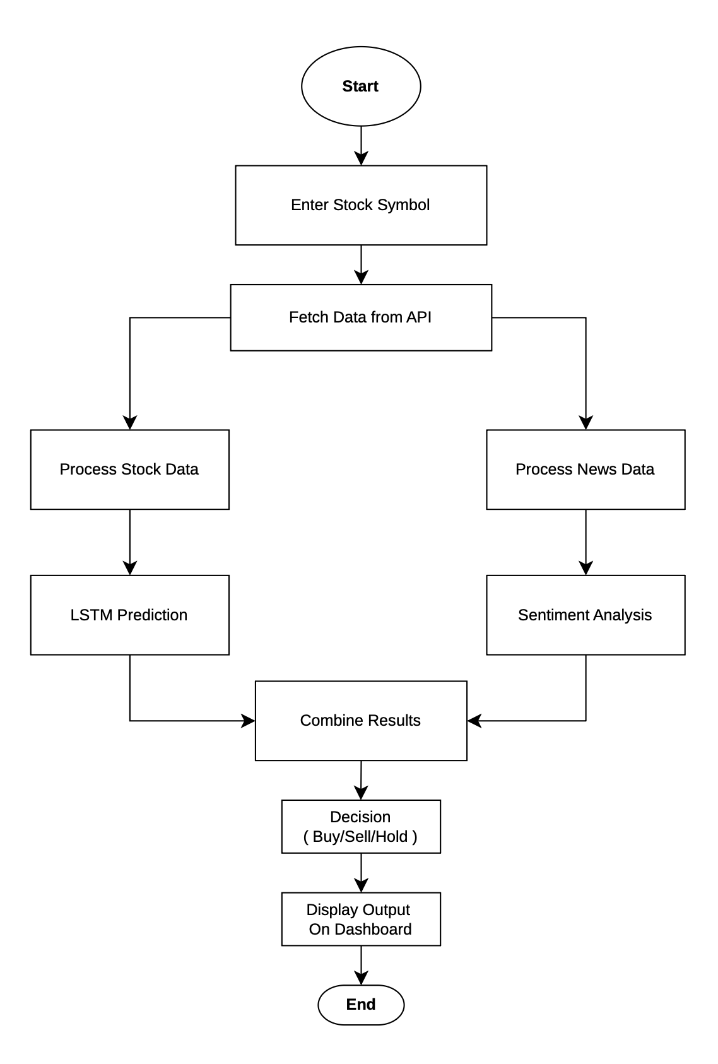
Data Flow Diagram
APCOER, Pune

Slide 18
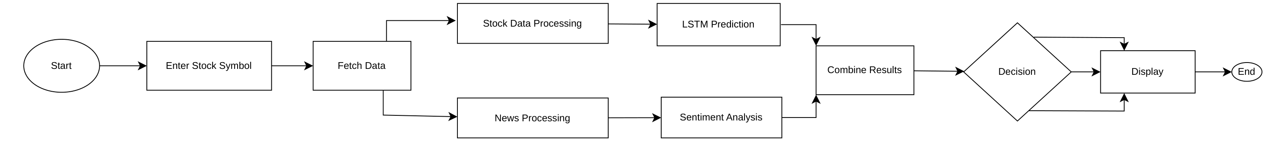
Activity Diagram
APCOER, Pune

Slide 19
Tools and Technologies
Software Requirements:
Programming: Python
Libraries: NumPy, Pandas, TensorFlow, Scikit-learn, NLTK, Transformers
Frameworks: Streamlit, yfinance,
newsdata.io
Visualization: Matplotlib, Seaborn
Hardware Requirements:
Processor: Intel Core i5 or higher
RAM: Minimum 8 GB
Storage: ≥ 512 GB SSD
Internet: Stable connection for API streaming
APCOER, Pune

Slide 20
Results and Discussion
The system was tested using historical stock data and real-time news data.
The LSTM prediction model achieved high accuracy with:
Low error values (RMSE, MAE)
High R² score (~0.90)
Better performance than Linear Regression and Random Forest
The Sentiment Analysis model showed:
High accuracy (~92%)
Effective classification into Positive, Negative, Neutral
A strong relationship was observed between news sentiment and stock price movements.
The integrated system (prediction + sentiment):
Improves overall accuracy
The system provides real-time insights through a web dashboard, helping users make better decisions.
APCOER, Pune

Slide 21
Evaluation Metrics
Performance Metrics :
Algorithm | Accuracy | Complexity | Overfitting | Suitability
Linear Regression | Very High | Low | Low | Best (Linear Data)
LSTM | High | High | Medium | Sequential Patterns
Random Forest | Low | Medium | Low | Non-linear Data
Ensemble | Medium | High | Medium | Combined Models
APCOER, Pune

Slide 22
Evaluation Metrics
Performance Metrics :
Model | MAE | RMSE | R² Score
Linear Regression | 13.94 | 19.27 | 0.9643
Random Forest | 29.92 | 40.02 | 0.8459
Ensemble | 18.95 | 24.81 | 0.9408
LSTM | 21.18 | 27.53 | 0.9274
APCOER, Pune

Slide 23
Test Cases
Test cases are used to verify that the system functions correctly under different conditions and inputs.
A total of 110 test cases were designed to validate the stock prediction, sentiment analysis and overall system performance.
Link:
https://docs.google.com/spreadsheets/d/1yeus3vHP0j1HMpNypYvORa3WjNT6YrdQz6EosYj_LIw/edit?usp=sharing
APCOER, Pune

Slide 24

Conclusion
The proposed system presents an effective AI-based approach for stock market prediction by combining historical data analysis with real-time news sentiment analysis. The use of the LSTM model enables accurate capture of time-dependent patterns, while the sentiment analysis module provides valuable insights into market behavior influenced by public opinion. By integrating both quantitative and qualitative data, the system delivers more reliable and context-aware predictions. Overall, the web-based platform offers a user-friendly solution that supports informed and data-driven investment decisions.
APCOER, Pune

Slide 25
Future Scopes
Integrate social media sentiment (Twitter, Reddit) for deeper market insights
Develop mobile application for real-time access and alerts
Apply reinforcement learning for adaptive trading systems
Improve model accuracy using advanced deep learning techniques
Expand system to multiple markets (crypto, forex, commodities)
APCOER, Pune

Slide 26

References
Y. Liu, I. Lee, and H. Wang, “FinBERT: A Pretrained Language Model for Financial Sentiment Analysis,” arXiv preprint, arXiv:2006.08097, 2020.
J. Bollen, H. Mao, and X. Zeng, “Twitter Mood Predicts the Stock Market,” Journal of Computational Science, vol. 2, no. 1, pp. 1–8, 2021.
J. Patel, S. Shah, P. Thakkar, and K. Kotecha, “Predicting Stock Market Index Using Machine Learning Techniques,” Expert Systems with Applications, vol. 42, no. 4, pp. 2162–2172, 2022.
N. Zhang, “Stock Market Prediction with Deep Learning Models,” Procedia Computer Science, vol. 224, pp. 1139–1146, 2023.
S. Kumar and R. Roy, “Financial Sentiment Analysis and Its Impact on Stock Prediction,” IEEE Access, vol. 11, pp. 54120–54135, 2023.
D. Kahneman, “Sentiment Analysis Revisited: Behavioral Finance Perspectives,” CFA Institute Enterprising Investor, Nov. 2023.
APCOER, Pune

Slide 27
Thank you !
APCOER, Pune

